Slide 1
Instacart marketing strategy case study
Austin Crehan

Slide 2
Instacart marketing strategy
Overview: You’re an analyst for an existing company, Instacart, an online grocery store that operates through an app. Instacart already has very good sales, but they want to uncover more information about their sales patterns.
Objective: Perform an initial data and exploratory analysis of sales data for Instacart, an online grocery store, to uncover more information about their sales patterns.
DATA
TOOLS
SKILLS
Datasets provided by Instacart
Fictional customer data
Python 3
Jupyter Notebook
Pandas, Seaborn, Numpy, and Matplotlib libraries
Wrangling and cleaning data with Python
Deriving variables
Data aggregation
Manipulating data frames
Creating pivot tables with Pandas
Data visualization with matplotlib and Seaborn

Slide 3
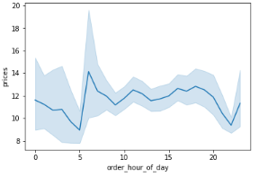
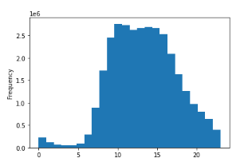
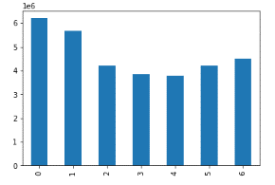
Analyzing sales trends
Price by Hour of Day
Sales by Hour of Day
Sales by Day of Week
Prices generally are reflective of sales volume, higher during the day and lower at night
Prices peak during the morning sales increase, generally at 7 AM
Prices remain high during the sales peak, begin to decrease at 5 PM
Sales hit a low overnight at 3 AM
Starting at 5 AM, sales rapidly increase until 10 AM
From 10 AM until 4 PM, sales peak
After 4 PM, sales gradually decrease again
Sales are highest on the weekends with Saturday being the highest, closely followed by Sunday
Sales decrease during the week, hitting a bottom on Tuesday and Wednesday

Slide 4
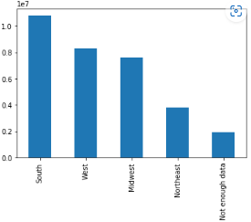
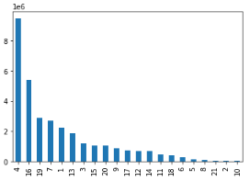
Analyzing REVENUE TRENDS
The South generates the most revenue – 1.2x more than the West and Midwest and 3x the Northeast
The Northeast by far generates the least revenue
Significant amount of data classified as ‘Not enough data’
Produce and Dairy dominate revenue compared to all other departments
Revenue by Region
Revenue by Department

Slide 5
Instacart marketing strategy recap
RESULTS
FURTHER ANALYSIS TO CONDUCT
Prices generally are reflective of sales volume, higher during the day and lower at night
Sales peak from 10 AM – 4 PM
Sales are highest on the weekends with Saturday being the highest, closely followed by Sunday
The South generates the most revenue – 1.2x more than the West and Midwest and 3x the Northeast
Produce and Dairy dominate revenue compared to all other departments
What impact do holidays have on sales data? Is there seasonality present?
Significant amount of revenue by region classified as ‘Not enough data’ and the Northeast generates significantly less revenue than the other three regions – is there a possibility there is a systematic issue with the data and the ‘Not enough data’ should be classified as revenue from the Northeast?
Is department revenue consistent across regions? Are some departments more popular in different regions?
LINKS
Github
Visualizations
Report

